Slide 1
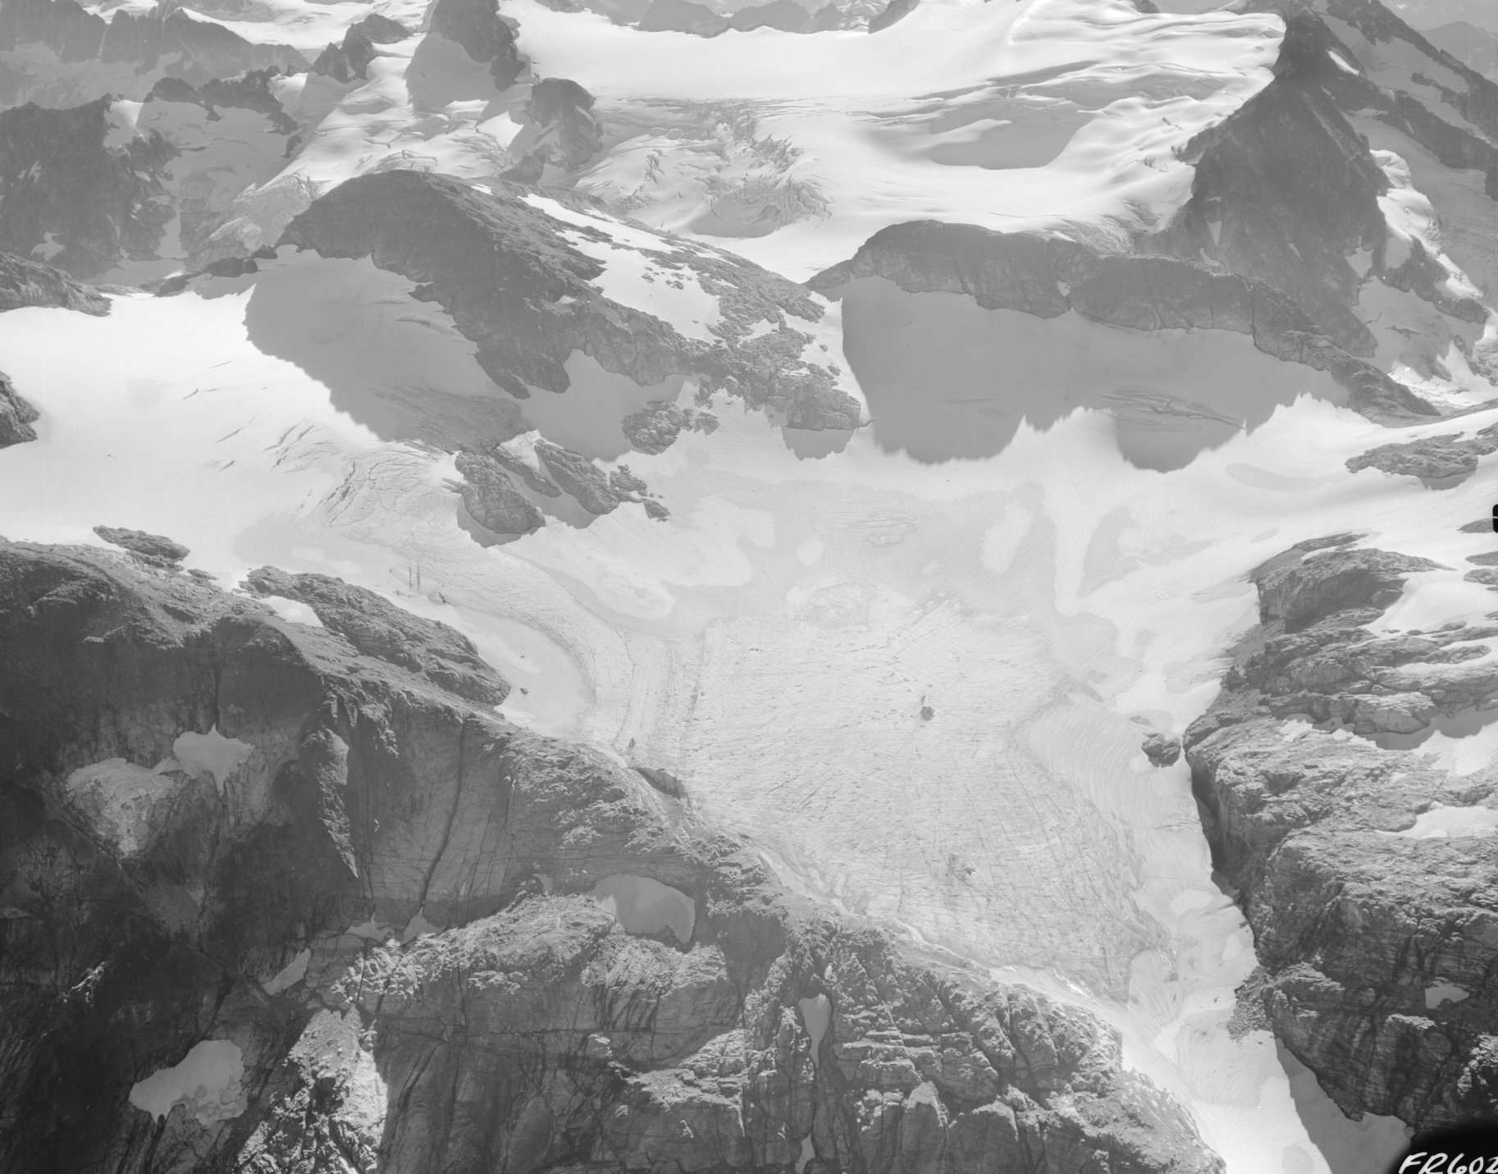
Colonial Glacier – 1960 (Post)
Notes:
HR 7Mb

Slide 2
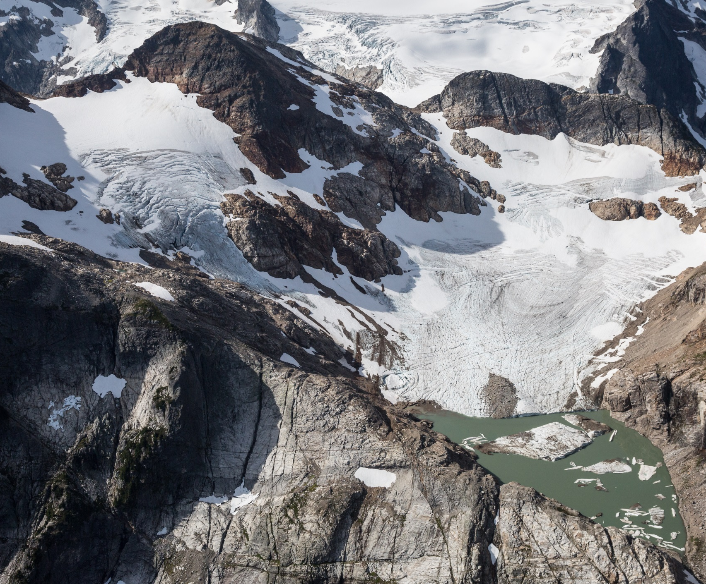
2016 (Scurlock)

Slide 3
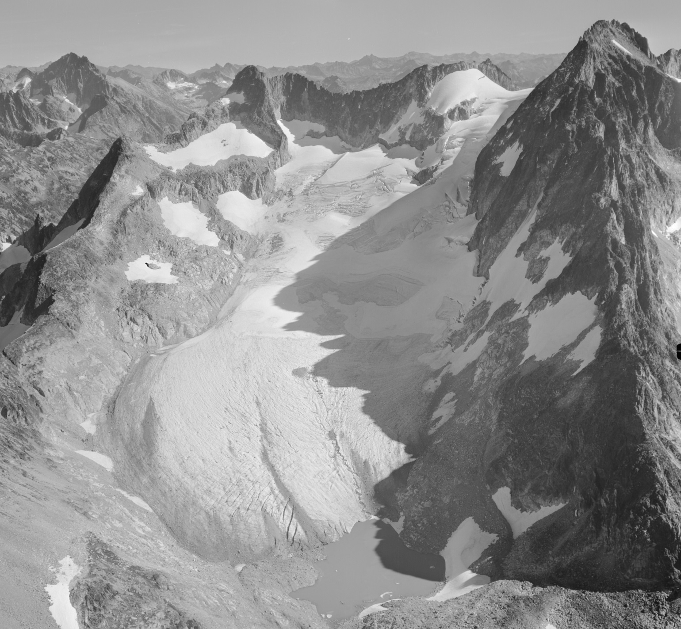
Banded Glacier – 1960 (Post)
Notes:
HR 7 Mb

Slide 4
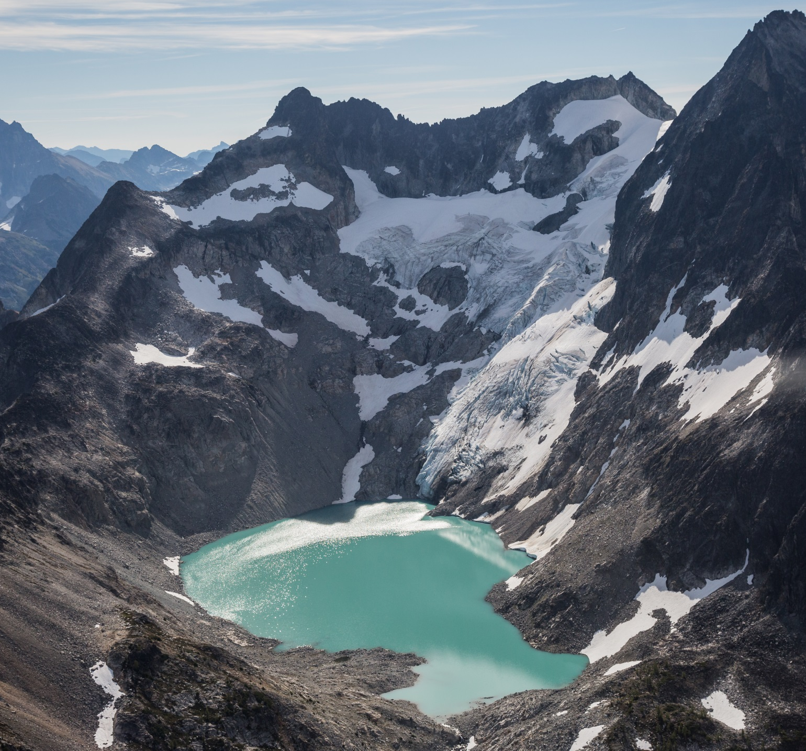
2016 (Scurlock)
Notes:
HR 14 Mb

Slide 5
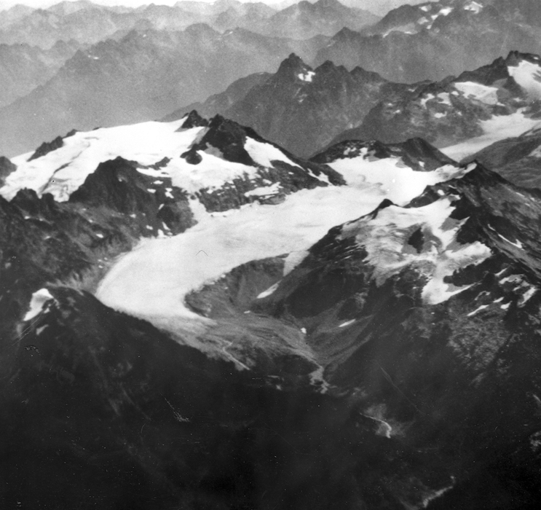
South Cascade Glacier - 1929

Slide 6
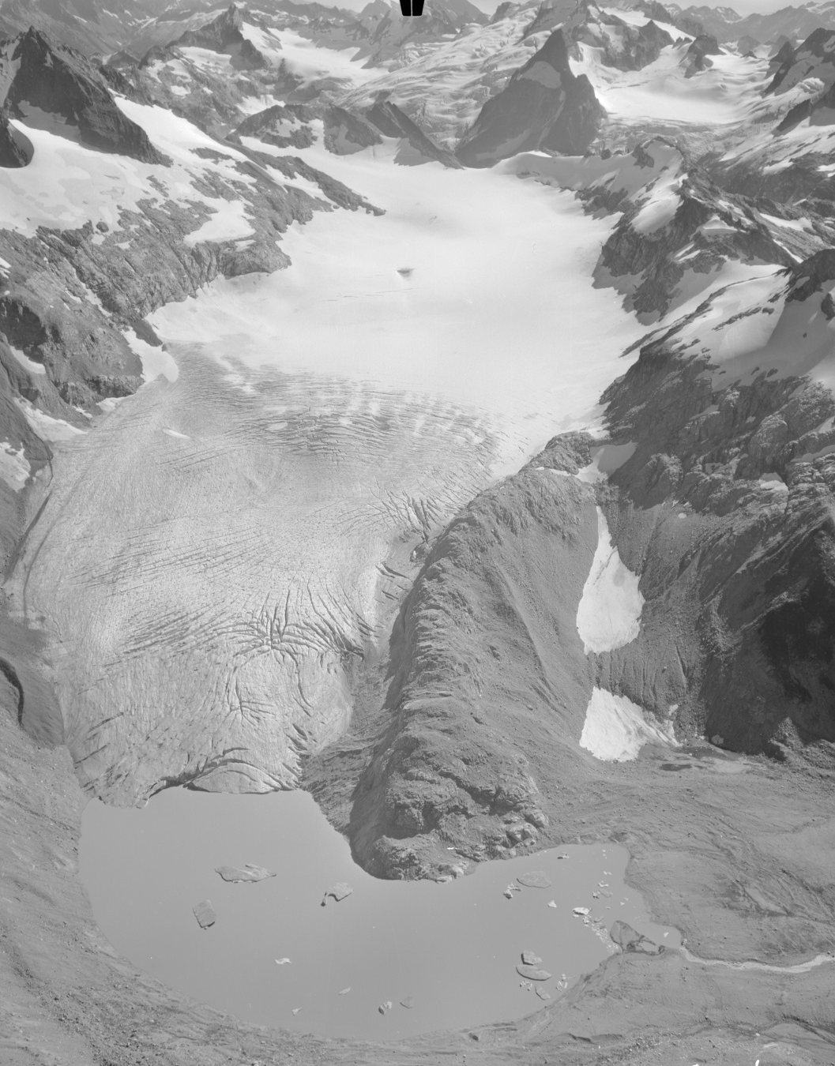
1960 (Post)
Notes:
HR 6.5 Mb

Slide 7
2004 (Scurlock)

Slide 8
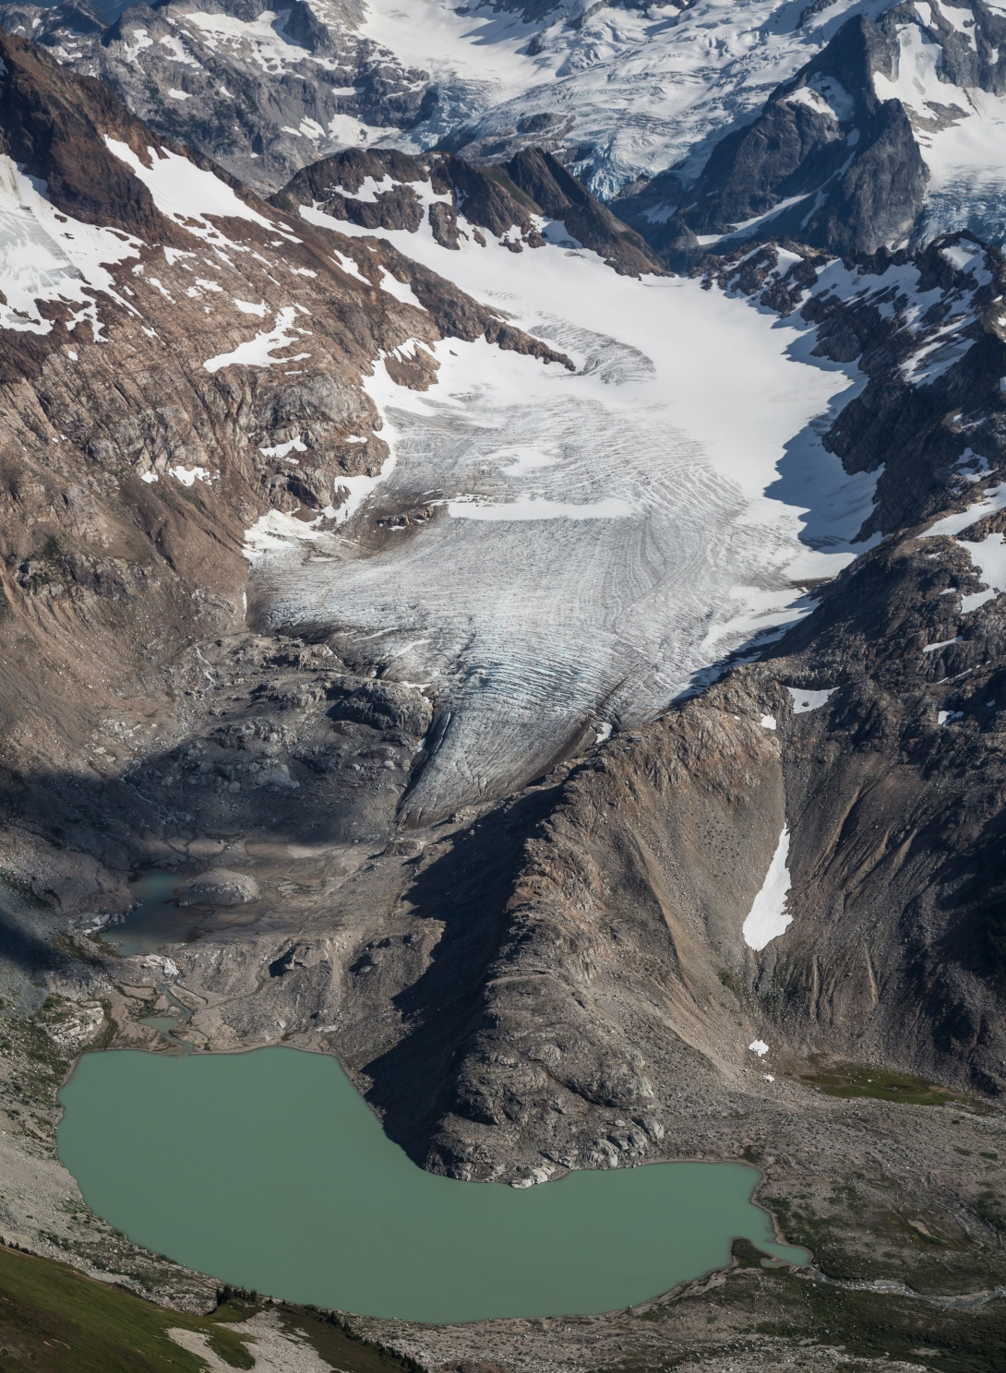
2016 (Scurlock)
Notes:
HR 15 Mb

Slide 9
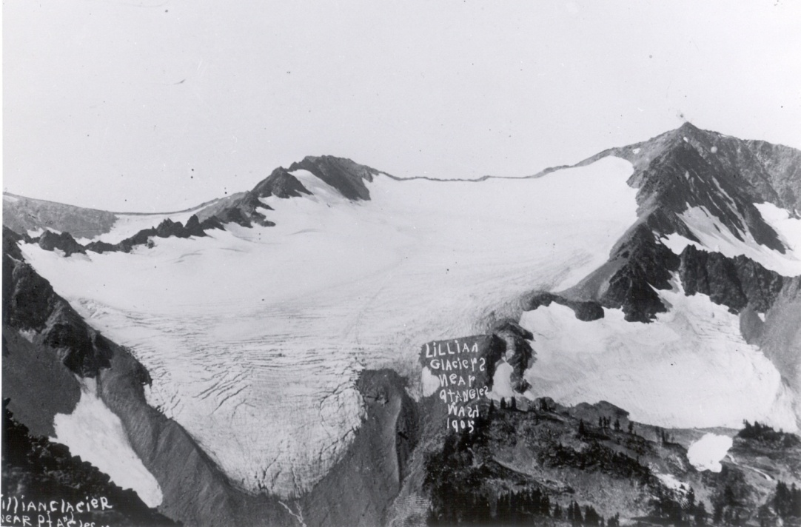
Lillian Glacier - 1905
Notes:
HR 1.1 Mb

Slide 10
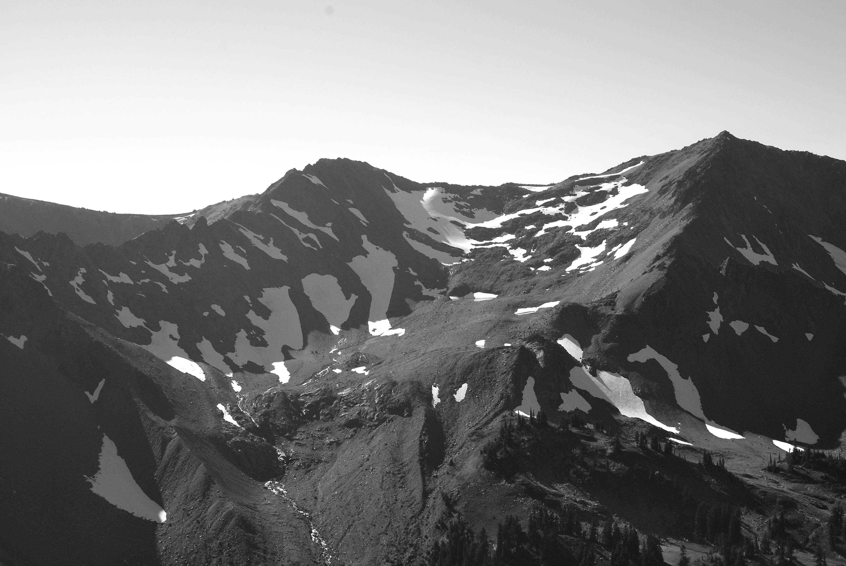
2010 (Baccus)
Notes:
HR 1.1 Mb

Slide 11
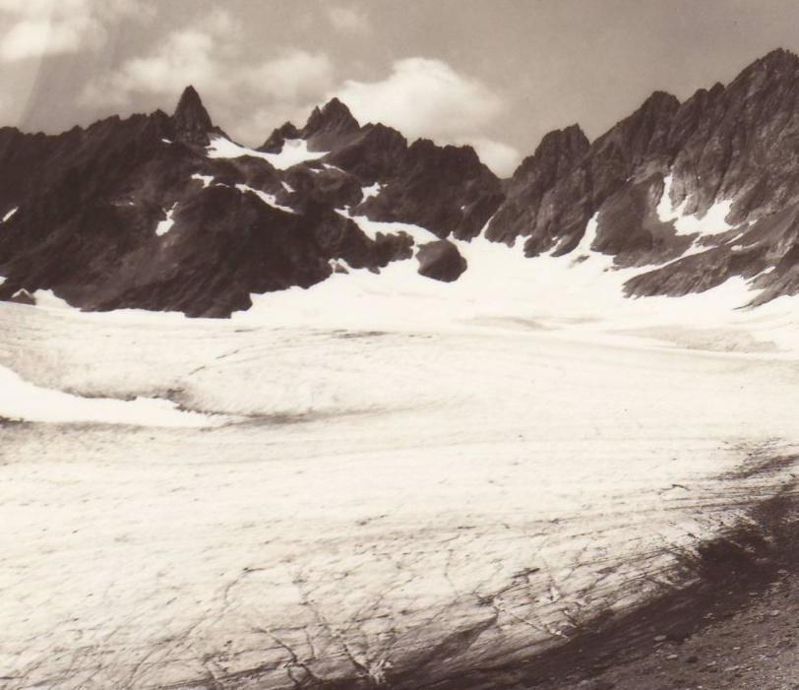
Anderson Glacier - 1936 (Curtis)
Notes:
In 1936 the valley below Anderson Peak was filled with ice and there was no lake.

Slide 12
2004 (Adams)

Slide 13
2015 (Adams)

